Slide 1







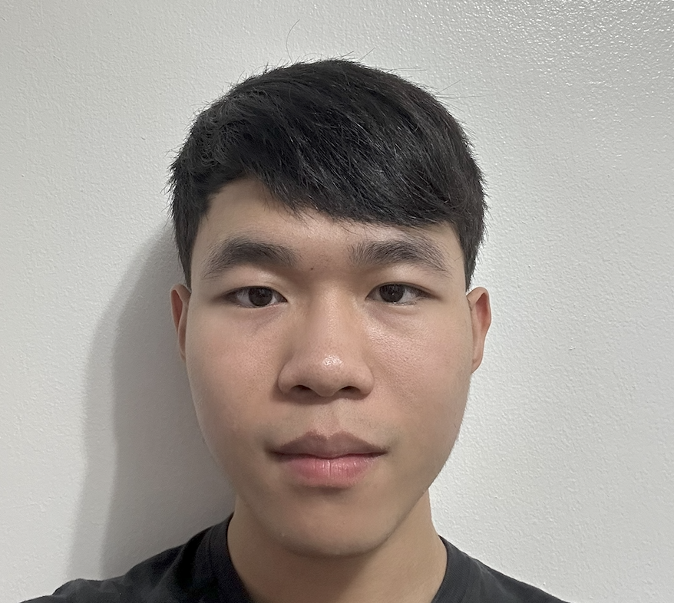








AppWorld
A Controllable World of Apps and People
for Benchmarking Interactive Coding Agents
Harsh
Trivedi
Tushar
Khot
Mareike
Hartmann
Ruskin Manku
Vinty Dong
Edward Li
Shashank
Gupta
Ashish
Sabharwal
Niranjan Balasubramanian
Notes:
Hi everyone, I am Harsh Trivedi from Stony Brook University and I today will talk about “AppWorld: A controllable world of apps and people for benchmarking interactive coding agents”. This is a joint work with collaborators from stony brook university, allen institute for AI and Saarland University.

Slide 2










Day-to-Day Tasks
Hey AI! Here are my app accounts. Do these tasks for me.
The last t-shirt I bought on Amazon, doesn’t fit me.
Please initiate its return and buy it in one size larger.
I owe money to some of my friends on Splitwise.
Please pay them on Venmo and clear Splitwise.
Play my Spotify playlist with enough songs for the workout today. My workout plan is in SimpleNote.
Can AI agents do such day-to-day tasks on our behalf?
Notes:
Our day-to-day digital lives involve doing various tasks on our app accounts, such as returning an Amazon order and buying a replacement, and sending owed money to friends on Venmo. Can AI agents do such tasks on our behalf?

Slide 3
Day-to-Day Tasks
Hey AI! Here are my app accounts. Do these tasks for me.
The last t-shirt I bought on Amazon, doesn’t fit me.
Please initiate its return and buy it in one size larger.
I owe money to some of my friends on Splitwise.
Please pay them on Venmo and clear Splitwise.
Play my Spotify playlist with enough songs for the workout today. My workout plan is in SimpleNote.
Can AI agents do such day-to-day tasks on our behalf?
Notes:
To make it more concrete, consider a running example. “Play my Spotify playlist with enough songs for the workout today. My workout plan is in SimpleNote.”

Slide 4
Interactive Coding Agents for Personal Apps
LMs could tackle such tasks by calling APIs with rich & interactive coding.
Notes:
One way models can tackle such tasks is by writing code that calls apps’ APIs. But since the tasks are complex, this code has to be rich and has to be written interactively.

Slide 5
Interactive Coding Agents for Personal Apps
LMs could tackle such tasks by calling APIs with rich & interactive coding.
Play my Spotify playlist with enough songs for the workout today.
My workout plan is in SimpleNote.
Joe
Notes:
Let me explain it by showing how an ideal agent could tackle our running example.

Slide 6

Interactive Coding Agents for Personal Apps
LMs could tackle such tasks by calling APIs with rich & interactive coding.
Play my Spotify playlist with enough songs for the workout today.
My workout plan is in SimpleNote.
Joe
Let me find Joe's today's workout plan.
token = simple_note.login(…)[“token”]
notes = simple_note.search_notes(“workout”, token)
print(notes[0]) # found one, show it …
APIs
Notes:
First, it has to find the user’s workout plan. For this, it gets the user’s SimpleNote credentials, logs in, searches for workout-related notes, and finds one, all via writing a code snippet making appropriate API calls to the SimpleNote app.
Next, it has to figure out the workout duration from the note. This it cannot do within the same code snippet even with the perfect knowledge of APIs input and output structure. This is because how to infer the duration for today depends on how the note’s content is structured.

Slide 7
Interactive Coding Agents for Personal Apps
LMs could tackle such tasks by calling APIs with rich & interactive coding.
Play my Spotify playlist with enough songs for the workout today.
My workout plan is in SimpleNote.
Joe
Let me find Joe's today's workout plan.
token = simple_note.login(…)[“token”]
notes = simple_note.search_notes(“workout”, token)
print(notes[0]) # found one, show it …
... Monday: ... 25 mins ... Tuesday ... 45 mins ...
Environment Interaction
Notes:
So it interacts with the environment by printing the note and seeing its content.

Slide 8
Interactive Coding Agents for Personal Apps
LMs could tackle such tasks by calling APIs with rich & interactive coding.
Play my Spotify playlist with enough songs for the workout today.
My workout plan is in SimpleNote.
Joe
Let me find Joe's today's workout plan.
token = simple_note.login(…)[“token”]
notes = simple_note.search_notes(“workout”, token)
print(notes[0]) # found one, show it …
... Monday: ... 25 mins ... Tuesday ... 45 mins ...
Plan is day-wise, let’s see what day is today.
print(datetime.now().strftime(“%A”))
Tuesday
Environment Interaction
Notes:
The agent discovers the workout plan in the note is structured day-wise, as opposed to date-wise, month-wise or any other way, so it prints the current day, again via environment interaction.

Slide 9
Interactive Coding Agents for Personal Apps
LMs could tackle such tasks by calling APIs with rich & interactive coding.
Play my Spotify playlist with enough songs for the workout today.
My workout plan is in SimpleNote.
Joe
Let me find Joe's today's workout plan.
Today is Tuesday, so it’s 45 mins. Now, let me play Joe’s playlist with enough songs for this duration.
token = simple_note.login(…)[“token”]
notes = simple_note.search_notes(“workout”, token)
print(notes[0]) # found one, show it …
... Monday: ... 25 mins ... Tuesday ... 45 mins ...
Plan is day-wise, let’s see what day is today.
print(datetime.now().strftime(“%A”))
Tuesday
Environment Interaction
Notes:
Finding it's Tuesday, it infers a 45-minute workout and searches for a playlist with enough songs for that duration.

Slide 10
Interactive Coding Agents for Personal Apps
LMs could tackle such tasks by calling APIs with rich & interactive coding.
Play my Spotify playlist with enough songs for the workout today.
My workout plan is in SimpleNote.
Joe
Let me find Joe's today's workout plan.
Today is Tuesday, so it’s 45 mins. Now, let me play Joe’s playlist with enough songs for this duration.
token = simple_note.login(…)[“token”]
notes = simple_note.search_notes(“workout”, token)
print(notes[0]) # found one, show it …
workout_mins = 45
token = spotify.login(…)["token"]
playlists = spotify.playlist_library(token)
for playlist in playlists:
duration = 0
for id in playlist["song_ids"]:
duration += spotify.song(id)["duration"]
if total_duration >= workout_mins:
spotify.play(playlist["id"], token)
break
... Monday: ... 25 mins ... Tuesday ... 45 mins ...
Plan is day-wise, let’s see what day is today.
print(datetime.now().strftime(“%A”))
Tuesday
Environment Interaction
Rich Code
Notes:
This search involves writing rich code with various programming constructs like loops, conditionals, arithmetic, and so on.

Slide 11
Interactive Coding Agents for Personal Apps
LMs could tackle such tasks by calling APIs with rich & interactive coding.
Play my Spotify playlist with enough songs for the workout today.
My workout plan is in SimpleNote.
Joe
Let me find Joe's today's workout plan.
Today is Tuesday, so it’s 45 mins. Now, let me play Joe’s playlist with enough songs for this duration.
Seemingly simple day-to-day tasks
can be quite complex, with
Two Key Requirements 👇
token = simple_note.login(…)[“token”]
notes = simple_note.search_notes(“workout”, token)
print(notes[0]) # found one, show it …
workout_mins = 45
token = spotify.login(…)["token"]
playlists = spotify.playlist_library(token)
for playlist in playlists:
duration = 0
for id in playlist["song_ids"]:
duration += spotify.song(id)["duration"]
if total_duration >= workout_mins:
spotify.play(playlist["id"], token)
break
... Monday: ... 25 mins ... Tuesday ... 45 mins ...
Plan is day-wise, let’s see what day is today.
print(datetime.now().strftime(“%A”))
Tuesday
Environment Interaction
Rich Code
Notes:
In summary, we saw that a seemingly simple day-to-day task can be quite complex, and it has two key requirements. It necessitates environment interaction to write the next code snippet, and the code itself is rich with various programming constructs.

Slide 12

Interactive Coding Agents for Personal Apps
LMs could tackle such tasks by calling APIs with rich & interactive coding.
Play my Spotify playlist with enough songs for the workout today.
My workout plan is in SimpleNote.
Joe
How can we develop & benchmark such rich and
interactive coding agents for complex digital tasks
in a rigorous & reproducible manner?
1
3
Let me find Joe's today's workout duration.
Today is Tuesday, so it’s 45 mins. Now, let me play. Joe’s playlist with enough songs for this duration.
token = simple_note.login(…)[“token”]
notes = simple_note.search_notes(“workout”, token)
print(notes[0]) # found one, show it …
workout_mins = 45
token = spotify.login(…)["token"]
playlists = spotify.playlist_library(token)
for playlist in playlists:
duration = 0
for id in playlist["song_ids"]:
duration += spotify.song(id)["duration"]
if total_duration >= workout_mins:
spotify.play(playlist["id"], token)
break
... Monday: ... 25 mins ... Tuesday ... 45 mins ...
2
Plan is day-wise, let’s see what day is today.
print(datetime.now().strftime(“%A”))
Tuesday
Environment Interaction
Rich Code
Notes:
So the key question is:
How can we develop & benchmark such rich and interactive coding agents for complex digital tasks in a rigorous & reproducible manner?

Slide 13
How to Benchmark such Interactive Coding Agents?
We need three ingredients
Notes:
For this, we argue in the paper, we need three ingredients.

Slide 14
How to Benchmark such Interactive Coding Agents?
We need three ingredients
Environment
A rich & reproducible execution
environment of many API-operable apps
⚙️
Notes:
A rich and reproducible execution environment of many API-operable apps

Slide 15
How to Benchmark such Interactive Coding Agents?
We need three ingredients
Environment
A rich & reproducible execution
environment of many API-operable apps
⚙️
Benchmark
A set of complex tasks needing API
calls with rich & interactive coding
📊
Notes:
A benchmark of complex tasks requiring API calls with rich and interactive coding.

Slide 16
How to Benchmark such Interactive Coding Agents?
We need three ingredients
Environment
A rich & reproducible execution
environment of many API-operable apps
⚙️
Benchmark
A set of complex tasks needing API
calls with rich & interactive coding
📊
Evaluation Framework
A robust & programmatic evaluation
framework for checking goal completion
🧪
Notes:
And a robust and programmatic evaluation framework for checking goal completion.

Slide 17
How to Benchmark such Interactive Coding Agents?
We need three ingredients
Past works don’t support them
Environment
A rich & reproducible execution
environment of many API-operable apps
Not rich & reproducible
Small num. API implementations
or unstable real APIs.
⚙️
Benchmark
A set of complex tasks needing API
calls with rich & interactive coding
Not rich & interactive coding
Tasks require a simple sequence of 1-4 API calls.
📊
Evaluation Framework
A robust & programmatic evaluation
framework for checking goal completion
Not robust & programmatic
human/LM judge or reference -based
evaluation (task have many solutions!)
🧪
Gorilla (Patil et. al), ToolBench (Qin et. al), API-Bank (Li et. al), ToolTalk (Farn et. al), RestBench (Song et. al) …
Notes:
There are many recent tool-use benchmarks, but they don’t support these 3 requirements. [pause 1s]

Slide 18
How to Benchmark such Interactive Coding Agents?
AppWorld
Environment
A rich & reproducible execution
environment of many API-operable apps
⚙️
Engine
Benchmark
A set of complex tasks needing API
calls with rich & interactive coding
📊
Benchmark
Evaluation Framework
A robust & programmatic evaluation
framework for checking goal completion
🧪
Evaluation
Notes:
To bridge this gap, we introduce AppWorld -- which constitutes AppWorld Engine, Benchmark and Evaluation. Let’s begin with Engine.

Slide 19



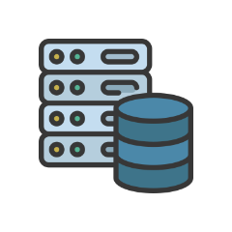
Engine
Benchmark
Evaluation
Apps
Has implementation of many day-to-day apps in a local backend of APIs and databases.
Amazon
Todoist
Venmo
SimpleNote
Spotify
Splitwise
Provides full control over its DB
state enabling challenging task
construction & robust evaluation.
Phone
Gmail
FileSystem
Fully Controllable
Local DB & API Server
Notes:
AppWorld Engine has implementation of many day-to-day apps in a local backend of APIs and databases.
It provides full control over its database state which enables challenging task construction & robust evaluation.

Slide 20





Engine
Benchmark
Evaluation
Apps
Has implementation of many day-to-day apps in a local backend of APIs and databases.
Amazon
Todoist
Venmo
SimpleNote
Spotify
Splitwise
Provides full control over its DB
state enabling challenging task
construction & robust evaluation
Phone
Gmail
FileSystem
Fully Controllable
Local DB & API Server
People
Apps populated with realistic simulated digital activities of people on their app accounts.
Provides a realistic environment
foundation to build tasks on top of
Notes:
These apps are also populated with simulated digital activities of people on their app accounts.
This provides a foundation of a realistic environment to build tasks on top of.

Slide 21
Engine
Benchmark
Evaluation
Apps
Has implementation of many day-to-day apps in a local backend of APIs and databases.
Amazon
Todoist
Venmo
SimpleNote
Spotify
Splitwise
⇒ High Fidelity: 60K+ code lines,
457 APIs, 100+ DB tables
⇒ Reliable: 1700+ unit tests
⇒ Documented API specs
Phone
Gmail
FileSystem
Fully Controllable
Local DB & API Server
People
Apps populated with realistic simulated digital activities of people on their app accounts.
Provides a realistic environment
foundation to build tasks on top of
Notes:
Our app implementations are high-fidelity simulators of the corresponding apps. They span over 60K lines of code, have 457 APIs with detailed documentation, and 100+ database tables.

Slide 22


Engine
Benchmark
Evaluation
Apps
Has implementation of many day-to-day apps in a local backend of APIs and databases.
Amazon
Todoist
Venmo
SimpleNote
Spotify
Splitwise
⇒ High Fidelity: 60K+ code lines,
457 APIs, 100+ DB tables
⇒ Reliable: 1700+ unit tests
⇒ Documented API specs
Phone
Gmail
FileSystem
Fully Controllable
Local DB & API Server
People
Apps populated with realistic simulated digital activities of people on their app accounts.
[phone.message]
Hey Roomie, have
you seen my car keys?
Roommate
[amazon.order]
Ordered two red
T-shirts for home delivery.
⇒ 106 fictitious people
⇒ Related via various relationships
⇒ Realistic (inter)personal
digital activities
Manager
[gmail.send_email]
Can you approve my
leave for tomorrow?
Notes:
These apps are also populated with realistic personal and interpersonal digital activities of fictitious people, related via various relationships, like roommate and manager, allowing for realistic tasks like splitting bills roommates.

Slide 23
Engine
Benchmark
Evaluation
Day-to-day rich & interactive coding tasks developed on Engine
Notes:
AppWorld benchmark builds tasks on top of this simulated world.

Slide 24
Engine
Benchmark
Evaluation
Day-to-day rich & interactive coding tasks developed on Engine
Play Spotify .. with enough songs …
Scenario
Naturally require rich & interacting coding
Notes:
We start with carefully crafted day-to-day scenarios which naturally require rich and interactive coding. This scenario is an ungrounded blueprint for the task.

Slide 25

Engine
Benchmark
Evaluation
Day-to-day rich & interactive coding tasks developed on Engine
Play Spotify .. with enough songs …
Scenario
3x
ground
Task
Generator Code
Notes:
For each scenario, we write a generator program to ground it into 3 varied tasks.

Slide 26


Engine
Benchmark
Evaluation
Day-to-day rich & interactive coding tasks developed on Engine
Play Spotify .. with enough songs …
Play my Spotify playlist with …
Instruction
Scenario
3x
ground
Task
Supervisor
Person in AppWorld
assigning the task
World State
The Initial DB State &
Time Now in World
Generator Code
Notes:
Each task is defined by three things.
The instruction.
The supervisor, who is the person in the world assigning the task.
and the world state, which is the database state and current time in the world.

Slide 27

Engine
Benchmark
Evaluation
Day-to-day rich & interactive coding tasks developed on Engine
Play Spotify .. with enough songs …
Play my Spotify playlist with …
Solution Code
+ Eval. Tests
Instruction
Scenario
3x
ground
Task
To Verify
Solvability
Supervisor
Person in AppWorld
assigning the task
World State
The Initial DB State &
Time Now in World
Generator Code
Notes:
For each task, we also write solution code and evaluation tests, that programmatically verify the task solvability.

Slide 28
Engine
Benchmark
Evaluation
Day-to-day rich & interactive coding tasks developed on Engine
Play Spotify .. with enough songs …
Play my Spotify playlist with …
Solution Code
+ Eval. Tests
Instruction
We write them individually
for every task/scenario
(40K+ lines of code)
Scenario
3x
ground
Task
To Verify
Solvability
Supervisor
Person in AppWorld
assigning the task
World State
The Initial DB State &
Time Now in World
Generator Code
Notes:
Note that we have written these codes individually for every task scenario.

Slide 29


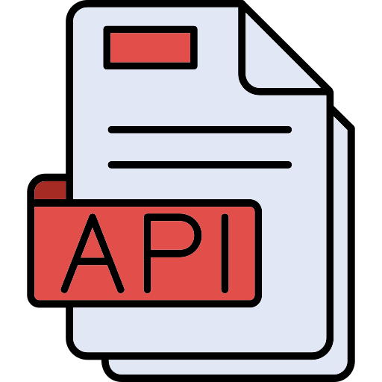

Engine
Benchmark
Evaluation
Day-to-day rich & interactive coding tasks developed on Engine
Play Spotify .. with enough songs …
Play my Spotify playlist with …
Solution Code
+ Eval. Tests
Instruction
Scenario
3x
ground
Task
To Verify
Solvability
Supervisor
Person in AppWorld
assigning the task
World State
The Initial DB State &
Time Now in World
Generator Code
Agent Given
Task
Instruction
Supervisor’s App Credentials
API Docs
of all Apps
Interactive
Coding Shell
(w/ API client)
Notes:
To complete the task, the agent is given
the instruction
supervisor’s credentials
all API documentation
and an interactive coding shell with an API client.

Slide 30




Engine
Benchmark
Evaluation
Generator Code
for each scenario ensures four task properties
Play my Spotify playlist with enough songs for the workout today.
My workout plan is in SimpleNote.
Property
Purpose
Is Well-Defined
To be solvable
Has Distractors
To necessitate thorough reasoning (avoid solvability by shortcuts)
Has Hurdles
Has Variations
To assess reliability across different instruction / state variations.
Notes:
Our generator codes for each scenario is carefully written to ensure four key task properties, namely:
The task is well defined meaning it is solvable.
It has distractors and hurdles meaning it necessitates thorough reasoning and avoids solvability via shortcuts.
and it has task variations to assess reliability across different instruction / state variations.

Slide 31
Engine
Benchmark
Evaluation
Generator Code
for each scenario ensures four task properties
Play my Spotify playlist with enough songs for the workout today.
My workout plan is in SimpleNote.
Property
Purpose
Is Well-Defined
To be solvable
Supervisor has several playlists.
Diff. workout durations for diff. days
Only one playlist qualifies for today
Skip a reasoning step ⇒ Fail!
Has Distractors
To necessitate thorough reasoning (i.e., no shortcuts)
Has Hurdles
Has Variations
To assess reliability across different instruction / state variations.
Notes:
E.g., to make sure there are distractors in the spotify task, we ensure the supervisor has several playlists, and different workout durations for different days, and only one playlist qualifies for their today’s workout.
-------
[remove] This means that if the agent skips a reasoning step, it’ll fail!

Slide 32
Engine
Benchmark
Evaluation
Generator Code
for each scenario ensures four task properties
Play my Spotify playlist with enough songs for the workout today.
My workout plan is in SimpleNote.
Property
Purpose
Is Well-Defined
To be solvable
Supervisor has several playlists.
Diff. workout durations for diff. days
Only one playlist qualifies for today
Skip a reasoning step ⇒ Fail!
Has Distractors
To necessitate thorough reasoning (i.e., no shortcuts)
Has Hurdles
Careful task construction possible as Engine gives full control over its state
Has Variations
To assess reliability across different instruction / state variations.
Notes:
Note that such careful task construction is possible because AppWorld engine gives full control over its initial state. Checkout other properties in the paper.

Slide 33
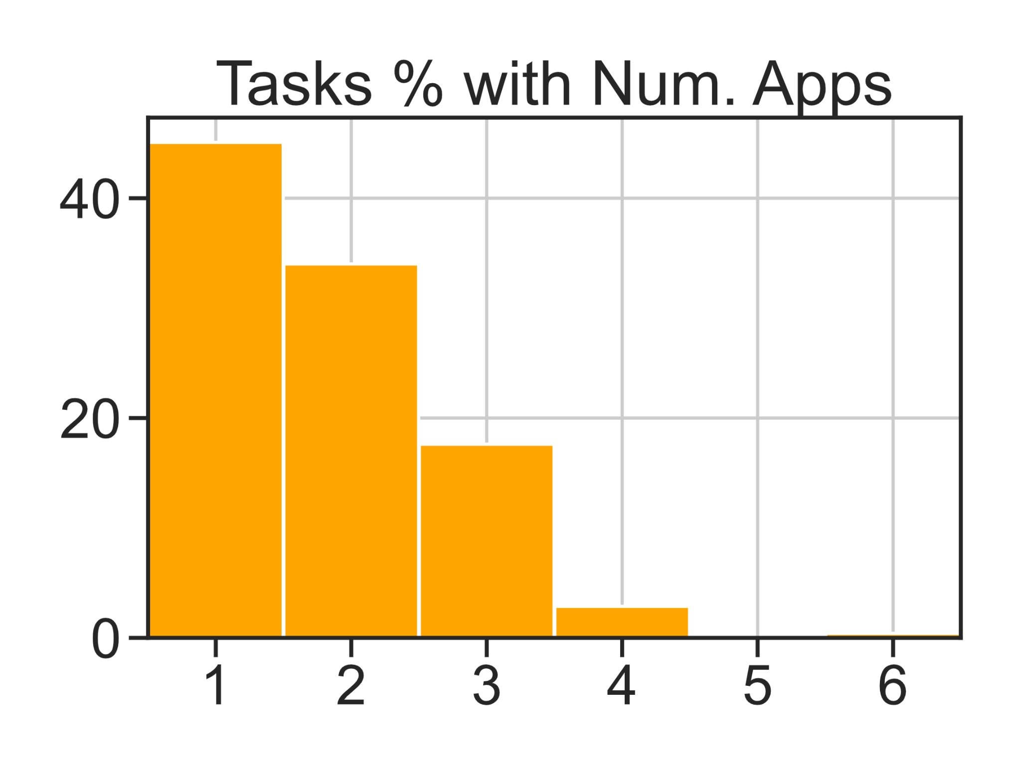
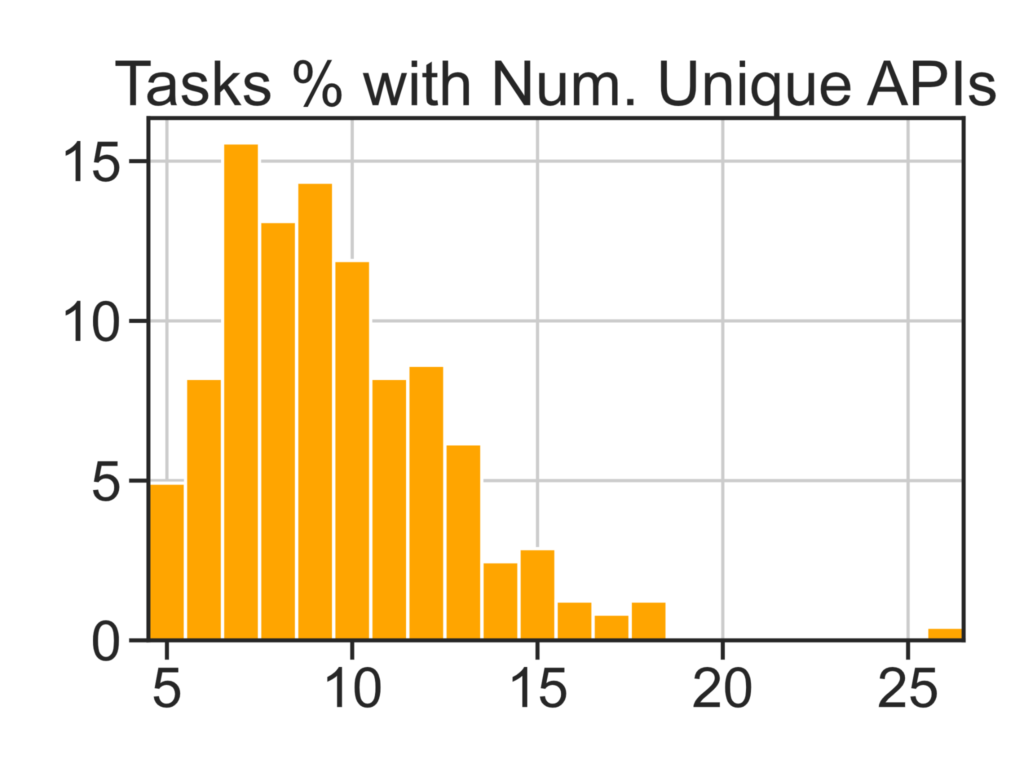
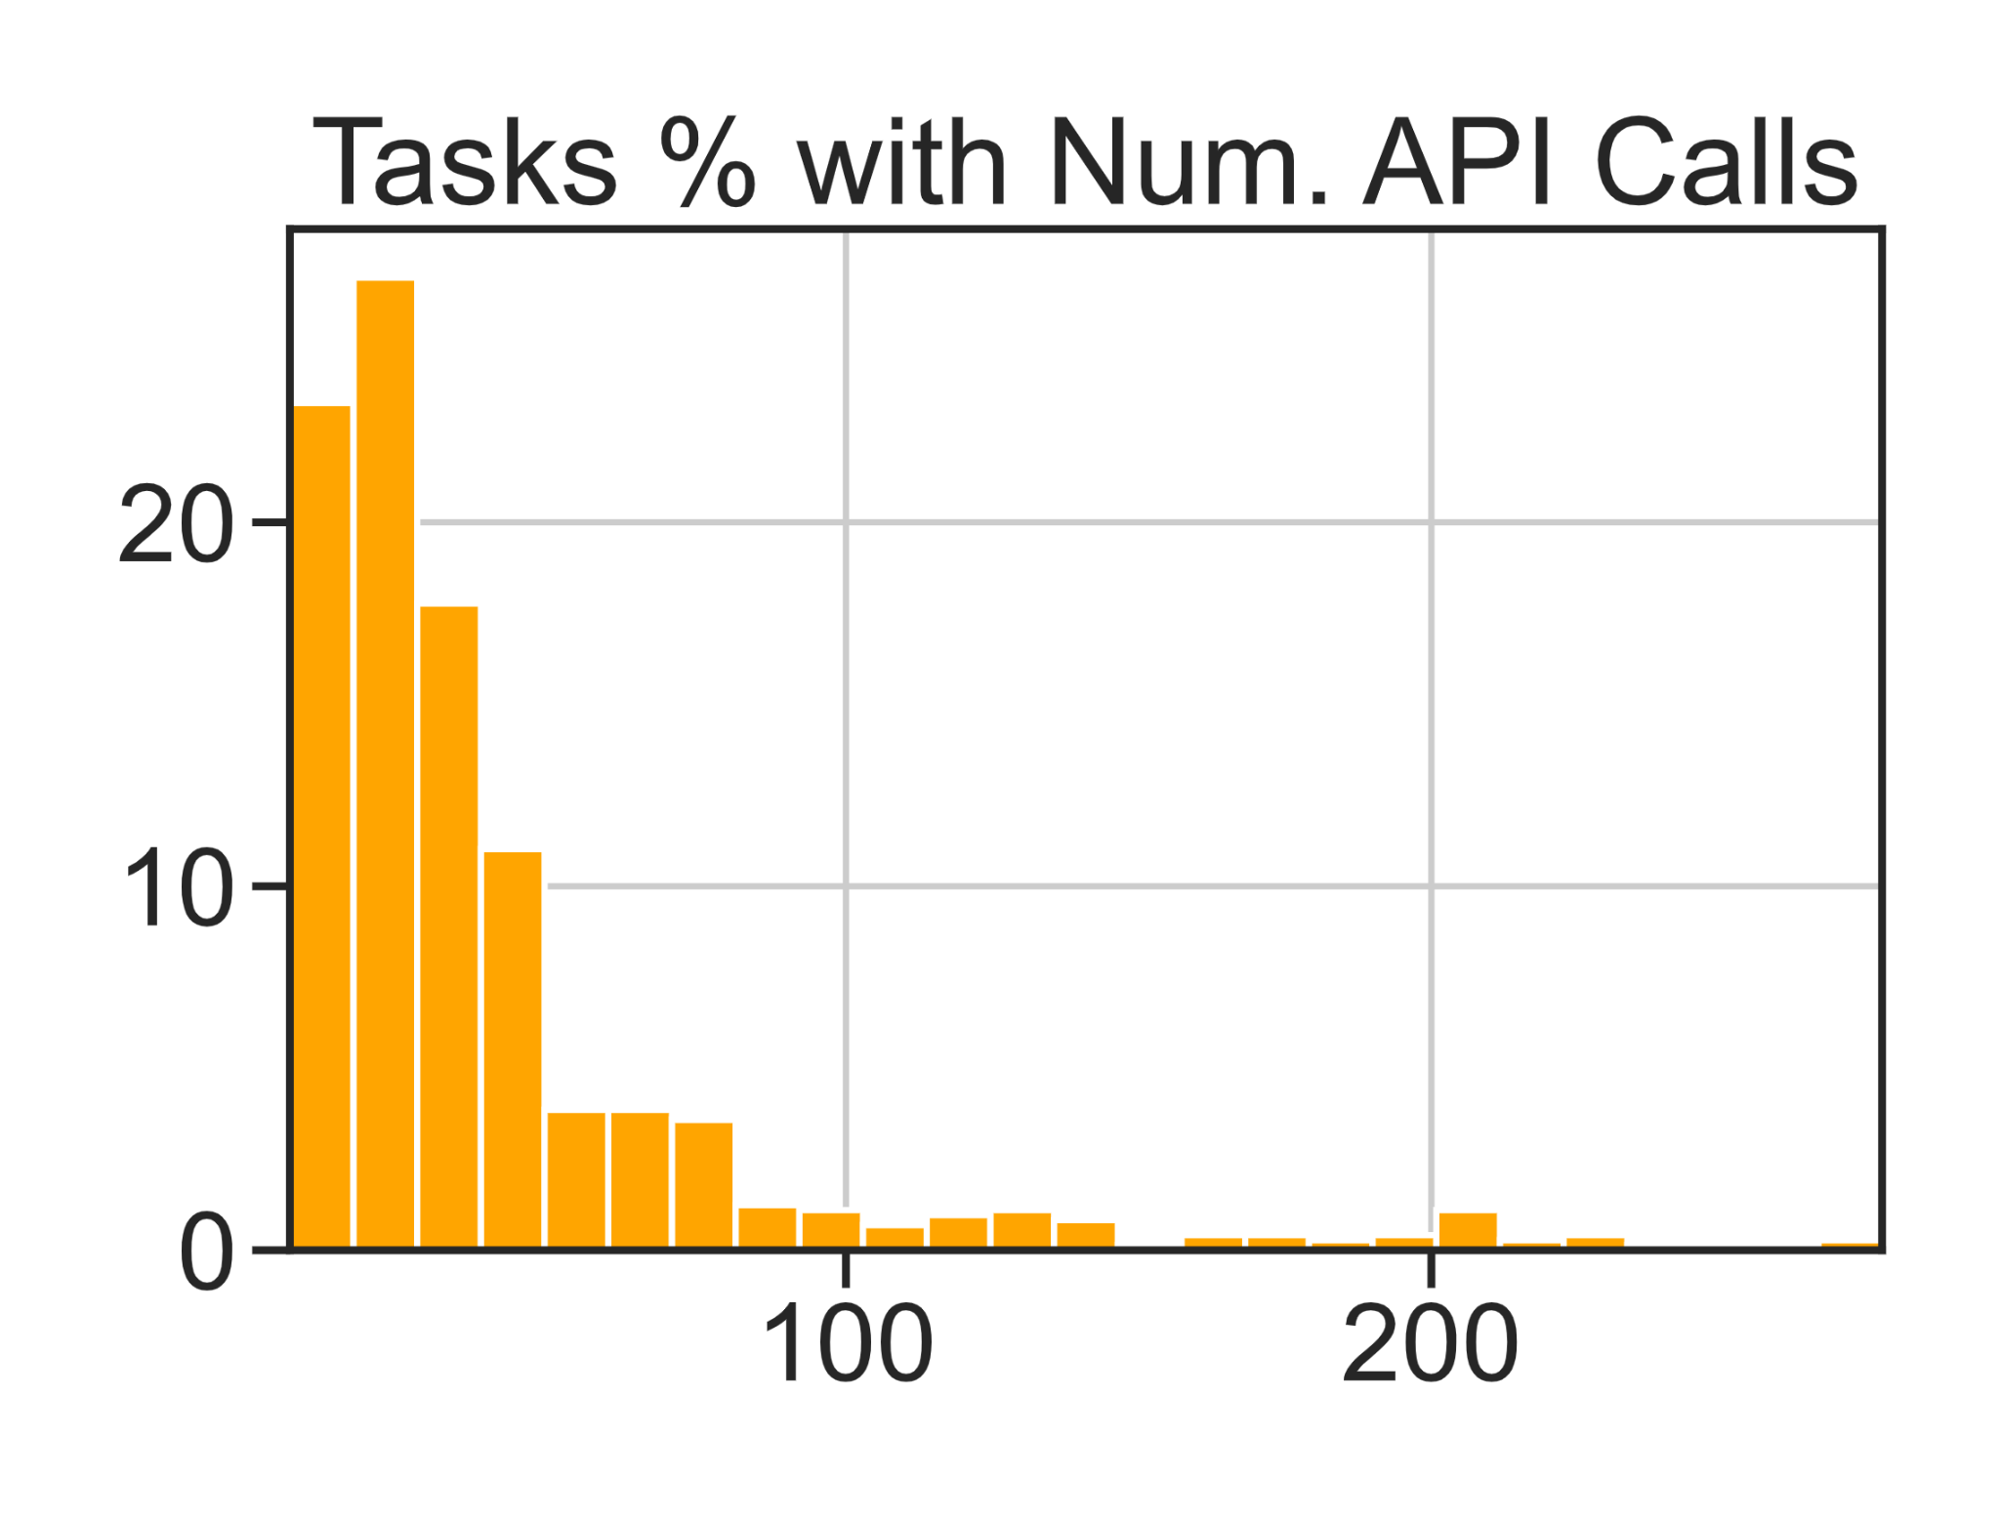
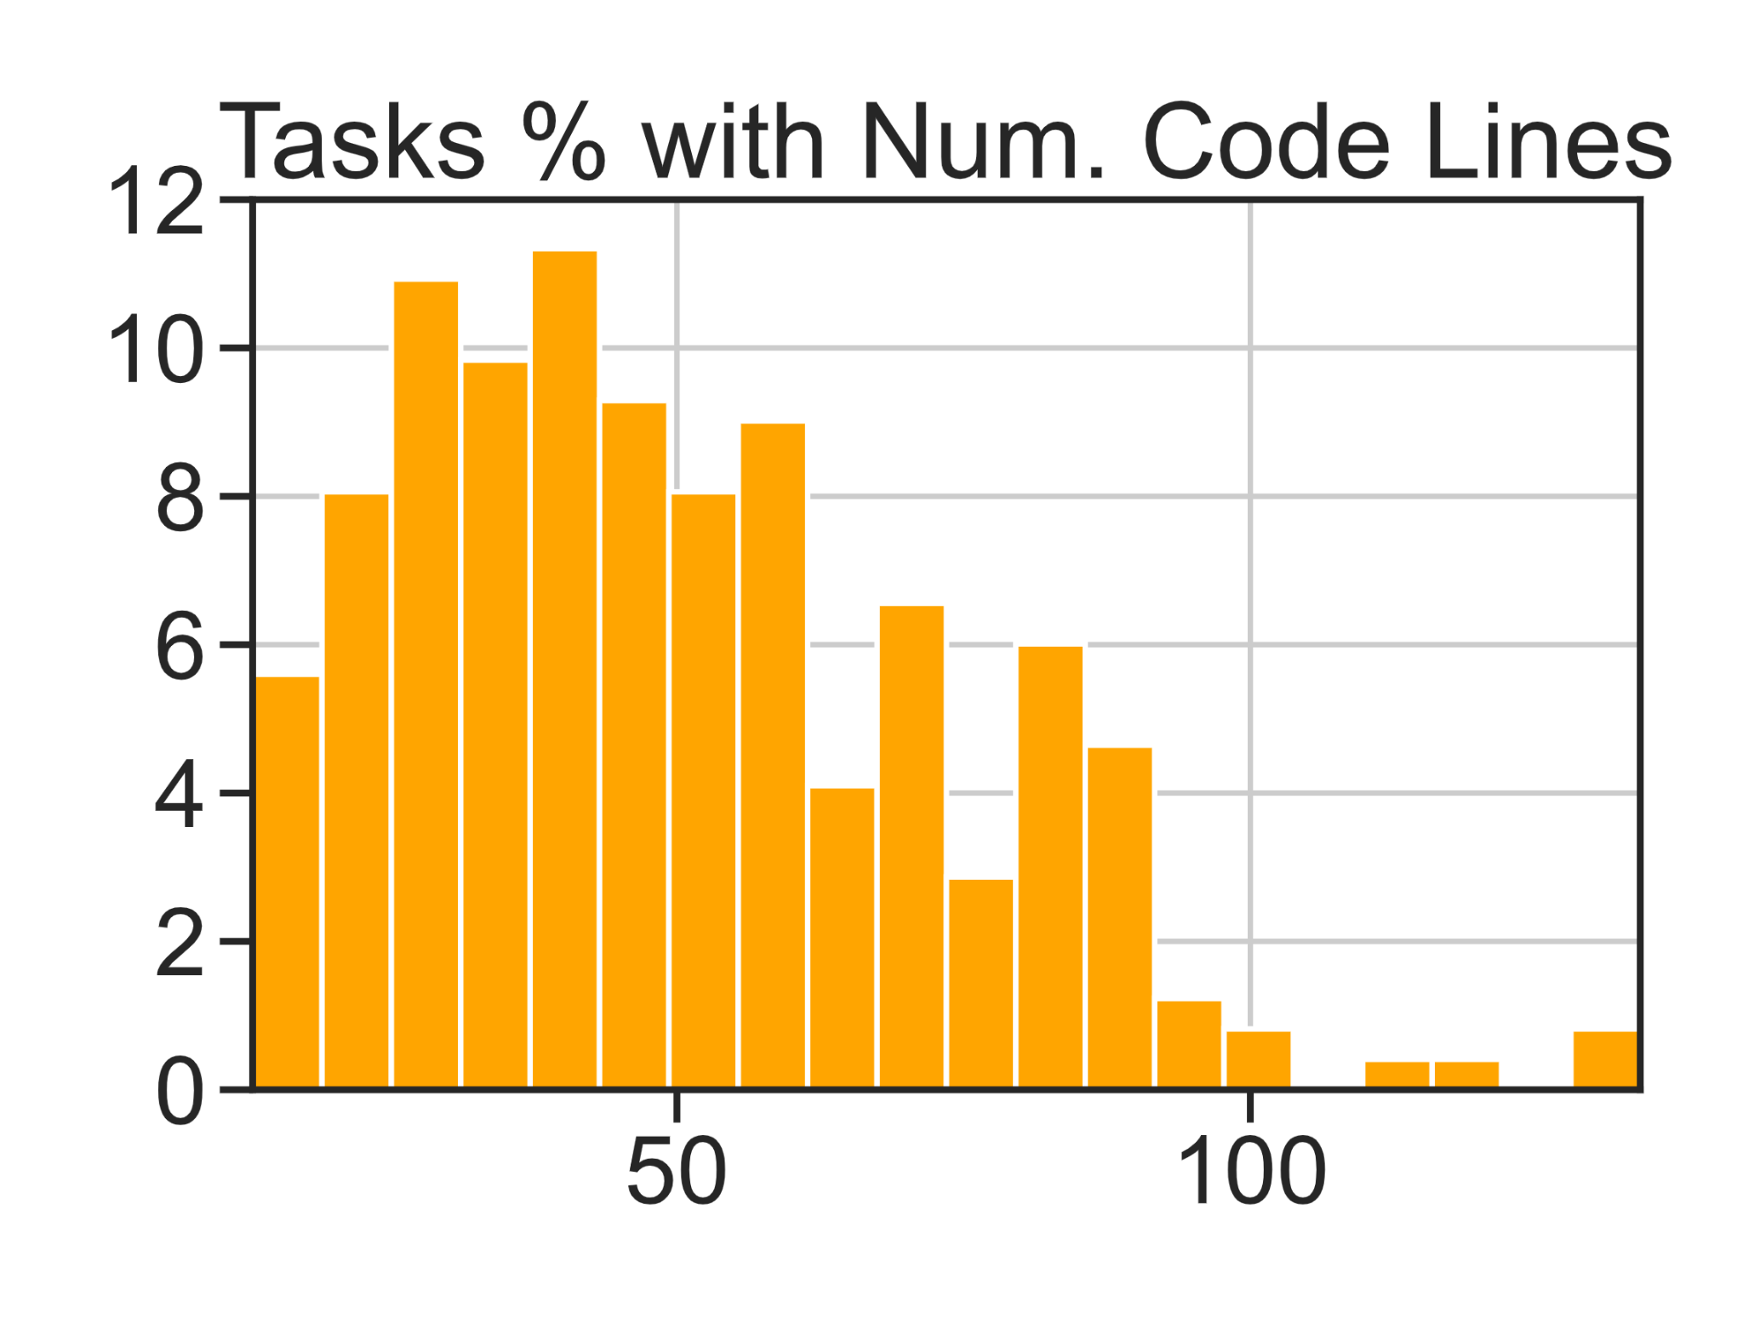
Engine
Benchmark
Evaluation
Dataset Statistics
1-4 apps
5-25 Unique APIs
10-200 API Calls
20-130 Code Lines
Notes:
Based on our solutions, we can see that tasks are challenging requiring multiple apps and many apis & lines of code, even when we have perfect knowledge of APIs. In practice, agents require a lot more code and API calls as they learn by interaction and exploration.

Slide 34
Engine
Benchmark
Evaluation
Dataset Statistics
Splits: 750
⇒ Train+Dev: 165
⇒ Test Normal: 168
⇒ Test Challenge: 417
1-4 apps
5-25 Unique APIs
Main Test Set
Challenging + Unseen Apps
10-200 API Calls
20-130 Code Lines
Notes:
Overall, we have 750 such tasks, with the Test-challenge split as the main test set, which includes higher complexity tasks and tests generalization to unseen apps. We also have Test-normal which has the same distribution as train and dev splits.

Slide 35
Engine
Benchmark
Evaluation
How to robustly evaluate agents on such tasks?
Notes:
Next, we need a robust way to evaluate agents.

Slide 36
Engine
Benchmark
Evaluation
How to robustly evaluate agents on such tasks?
Many valid ways of
completing the goal.
E.g., Amazon receipt downloadable from its API or email confirmation.
Many ways of
causing collateral damage.
E.g., deleting emails when asked for placing an Amazon order.
Notes:
Agents can solve such tasks in many ways. E.g., they can download amazon receipt from its API or its email confirmation, both are valid.
And agents can also cause collateral damage in many ways. E.g., deleting emails when asked for placing an Amazon order.

Slide 37


Engine
Benchmark
Evaluation
How to robustly evaluate agents on such tasks?
Many valid ways of
completing the goal.
E.g., Amazon receipt downloadable from its API or email confirmation.
Many ways of
causing collateral damage.
E.g., deleting emails when asked for placing an Amazon order.
Comparison to a reference code/API calls isn’t suitable
AppWorld uses State-based & Execution-based approach.
Notes:
So comparison to a reference solution cannot be used. Therefore, AppWorld uses a state and execution-based approach.

Slide 38

Engine
Benchmark
Evaluation
Start DB state
(before agent starts)
End DB state
(after agent ends)
Notes:
In particular, we compare the world states before the agent starts and after it ends.

Slide 39


Engine
Benchmark
Evaluation
Start DB state
(before agent starts)
End DB state
(after agent ends)
Database Difference
Added Row
Removed Row
Changed Column
email
song
todo
changed tables / rows / cols
Cumulative DB Changes
Notes:
We compute the difference in its underlying database states to obtain cumulative changes the agent has made to the tables, rows, and columns.

Slide 40



Engine
Benchmark
Evaluation
Start DB state
(before agent starts)
End DB state
(after agent ends)
Database Difference
Added Row
Removed Row
Changed Column
All Expected
DB Changes
email
song
todo
Check
Includes?
No Unexpected
DB Changes
changed tables / rows / cols
Cumulative DB Changes
Notes:
We then check that these changes include all expected and no unexpected changes for the task, as enumerated by us.

Slide 41

Engine
Benchmark
Evaluation
Programmatic Tests
Start DB state
(before agent starts)
End DB state
(after agent ends)
Spotify music player in playing state
Player queue duration >= 45 mins
All songs belong to user’s playlist.
Nothing else except player changed
Database Difference
Added Row
Removed Row
Changed Column
All Expected
DB Changes
email
song
todo
Check
Includes?
No Unexpected
DB Changes
changed tables / rows / cols
Cumulative DB Changes
Notes:
And the check itself is done via programmatic “unit” tests.

Slide 42
Engine
Benchmark
Evaluation
Evaluation Metrics
Start DB state
(before agent starts)
End DB state
(after agent ends)
1
Task Goal Completion:
All tests in a task pass.
Database Difference
2
Scenario Goal Completion:
All tests for all 3 tasks in a scenario pass.
Added Row
Removed Row
Changed Column
All Expected
DB Changes
email
song
todo
Check
Includes?
No Unexpected
DB Changes
changed tables / rows / cols
Cumulative DB Changes
Notes:
We have two evaluation metrics. Task goal completion which checks all tests in a task pass. And scenario goal completion which checks all tests for all 3 tasks in a scenario pass.

Slide 43
How do Agents perform on AppWorld?
Open and close LLMs with various few-shot prompting methods.
ReAct
Interleave reasoning thoughts
with Code snippet generation.
PlanExec
Generate high-level plan and then execute each of its step via ReAct.
IPFunCall
Iterative calls to
Parallel Function Calling
FullCodeRefl
Generate Full Code with multiple
rounds of reflexion retrials.
See paper for more agents (e.g., CodeAct, ToolLLM)
Notes:
Alright, so how do agents perform?
We benchmark open and close LLMs with various kinds of few-shot prompting methods: React, planning and execution, repeated parallel function calling, and full code generation with reflection and retrials.

Slide 44
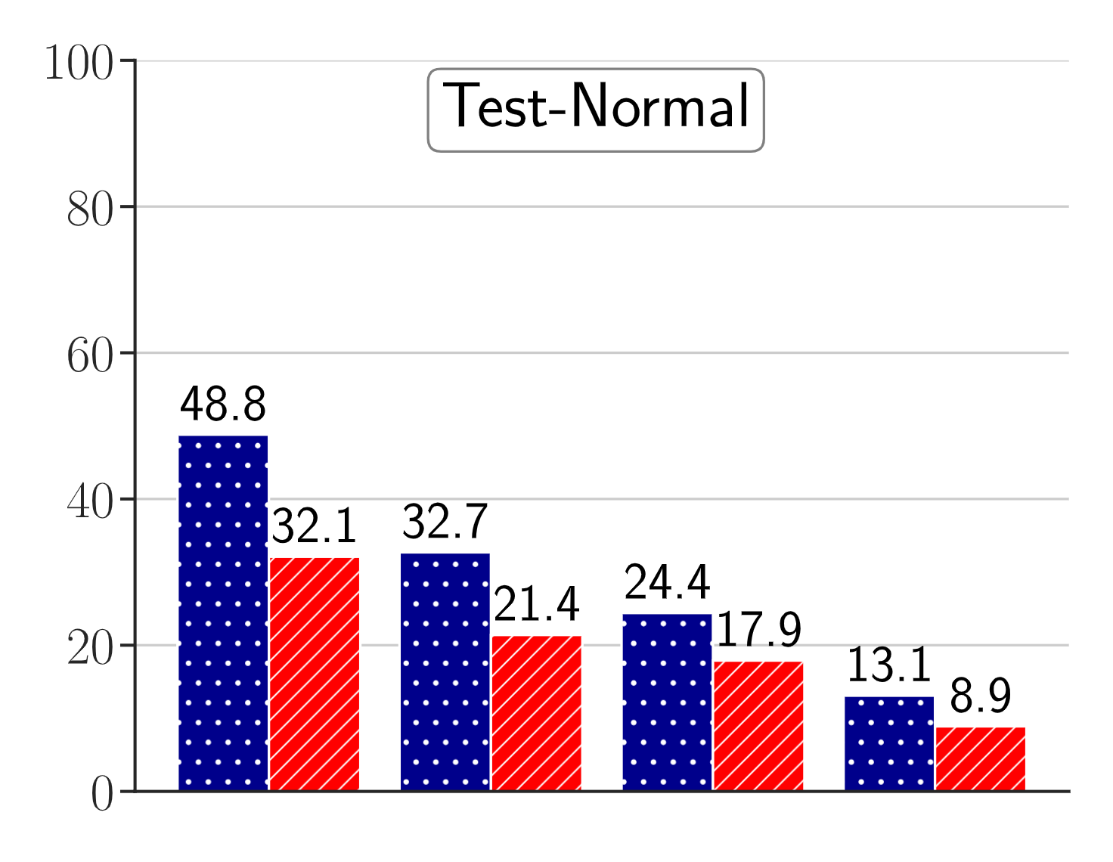

How do Agents perform on AppWorld?
State-of-the-art LLM agents struggle on AppWorld.
Task Goal Completion %
GPT-4o
GPT-4
Turbo
Test Normal
LLaMA3
70B
DeepSeek
Coder
For each LM, max score across 4 few-shot methods:
ReAct, PlanExec, FullCodeRefl, IPFunCall
Notes:
Here, the plot shows each LLM’s task goal completion on test-normal when paired with highest scoring prompting method. Even the best LLM GPT-4o gets under 50 points,

Slide 45

How do Agents perform on AppWorld?
State-of-the-art LLM agents struggle on AppWorld.
Task Goal Completion %
Scenario Goal Completion %
GPT-4o
GPT-4
Turbo
Test Normal
LLaMA3
70B
DeepSeek
Coder
For each LM, max score across 4 few-shot methods:
ReAct, PlanExec, FullCodeRefl, IPFunCall
Notes:
The scores significantly drop when we look at scenario goal completion. This shows that agents are not reliable, and fail to complete tasks under slightly different conditions.

Slide 46
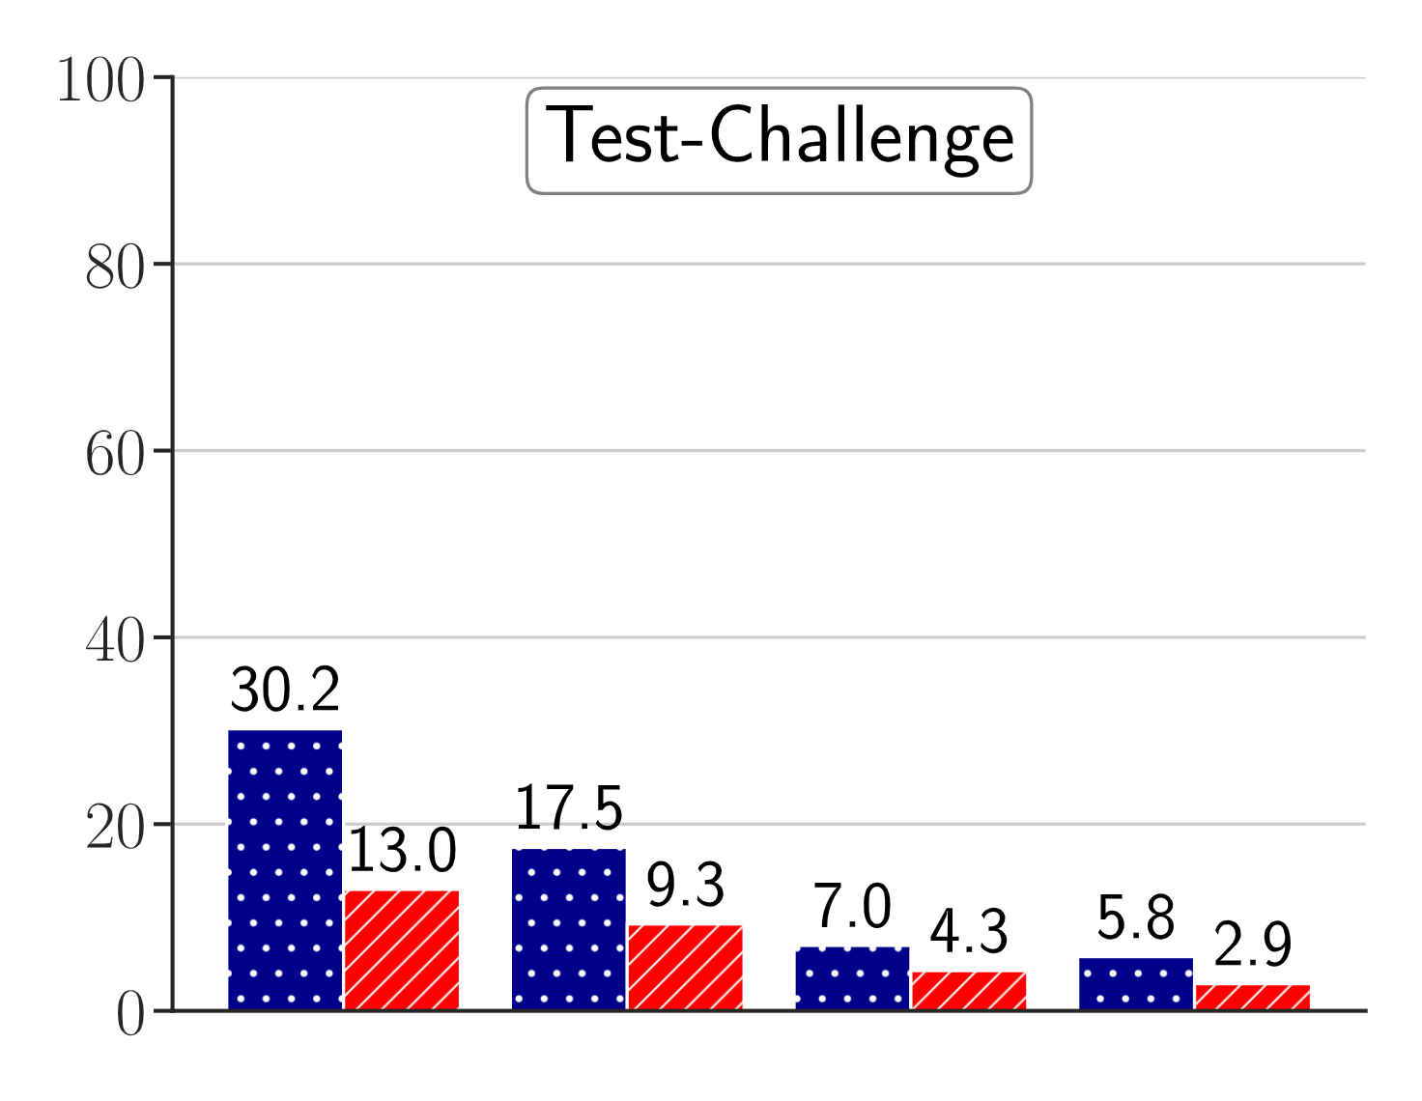
How do Agents perform on AppWorld?
State-of-the-art LLM agents struggle on AppWorld.
Task Goal Completion %
Scenario Goal Completion %
Test Challenge
GPT-4o
GPT-4
Turbo
LLaMA3
70B
DeepSeek
Coder
For each LM, max score across 4 few-shot methods:
ReAct, PlanExec, FullCodeRefl, IPFunCall
Notes:
Furthermore, all scores significantly drop on test-challenge, which is our main test set. E.g., GPT-4o only gets 13 percentage in scenario goal completion. [pause 1s]

Slide 47
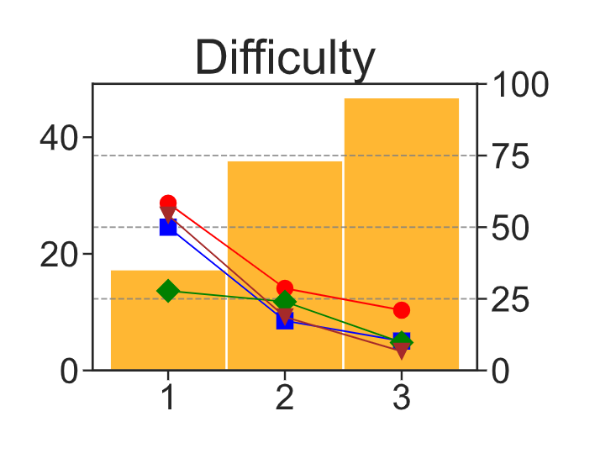




How do Agents perform on AppWorld?
Agent scores drop drastically as task difficulty increases.
GPT-4o Task Goal Completion % on Test Challenge
ReAct
Tasks %
Score
PlanExec
FullCodeRefl
IPFunCall
Notes:
The scores also drastically drop for all methods as task difficulty increases. E.g., as per our hand-labeled difficulty levels.

Slide 48
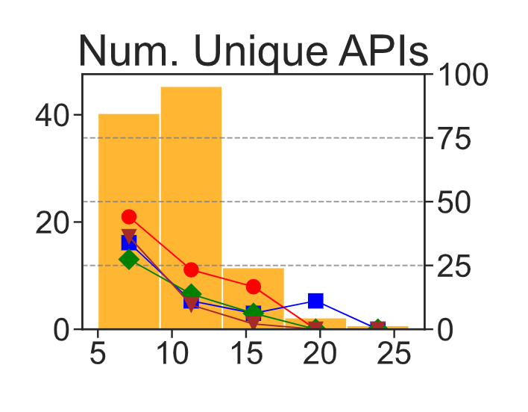
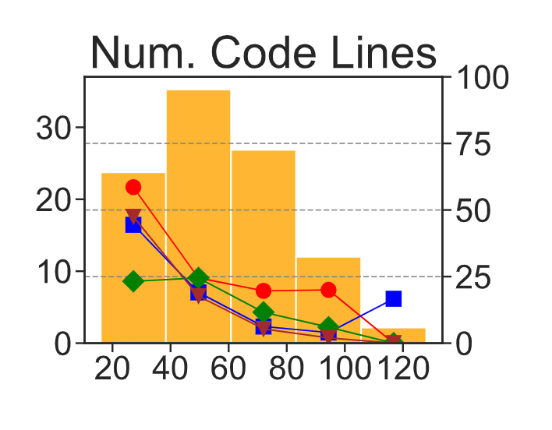
How do Agents perform on AppWorld?
Agent scores drop drastically as task difficulty increases.
GPT-4o Task Goal Completion % on Test Challenge
ReAct
Tasks %
Score
PlanExec
FullCodeRefl
IPFunCall
Difficulty
Tasks %
Score
Tasks %
Score
Num. APIs
Num. Code Lines
Notes:
and as per the number of APIs and the lines of code according to our solutions.

Slide 49


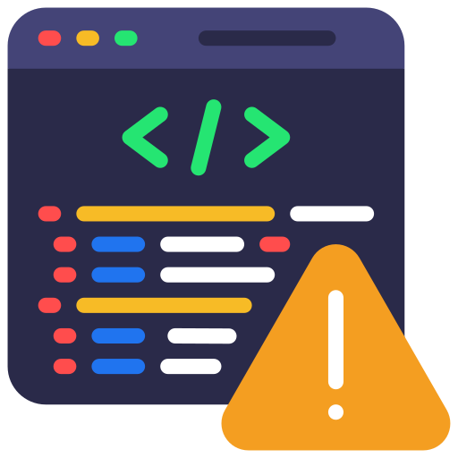

How do Agents perform on AppWorld?
Agent scores drop drastically as task difficulty increases.
Common Agent Errors
GPT-4o Task Goal Completion % on Test Challenge
ReAct
Lack of environment interaction
Tasks %
Score
PlanExec
API input/output fields hallucination
FullCodeRefl
IPFunCall
Coding mistakes
Difficulty
Common sense errors
Tasks %
Score
Tasks %
Score
Num. APIs
Num. Code Lines
Notes:
Finally, we find that agents make common errors such as assuming information instead of finding it, hallucinating API input and output fields and making various kinds of coding and common sense error.

Slide 50
Conclusion
AppWorld
World of Apps & People
⇒ 9 app implementations
⇒ High Fidelity: 457 APIs w/ docs,
100+ tables
⇒ Reliable: 1700+ unit tests
⇒ Simulated people + activities
[phone.message]
Hey Roomie, have
you seen my car keys?
Roommate
⇒ 750 complex tasks w/ 5-25 APIs,
1-6 apps per tasks , rich +
interactive coding (20-130 lines)
⇒ Robust programmatic eval
[gmail.send_email]
Can you approve my
leave for tomorrow?
Manager
100K+ lines of code
Notes:
In summary, we have introduced AppWorld, which was borne out of a significant engineering effort by our team writing over 100K lines of code, delivering a high quality, realistic, environment, complex tasks, and robust programmatic evaluation for benchmarking interactive coding agents.

Slide 51






Future Possibilities
Better
Agents
Self-
exploration
Learning
from Feedback
New Agent
Benchmarks
UI-based Control
(coming soon!)
Multi-Agent
+ Human tasks
Study Agents in
Environment
Study safety & privacy risks
Study social dynamics of role-playing agents
Notes:
We are excited for the opportunities that AppWorld opens for future work in building better agents, creating new agent benchmarks, and studying agents in a simulated environment.
E.g.,
using self-exploration for generate training data
adding UI support for multi-modal agents
studying safety and privacy risks of personal agents
I am happy to discuss this more offline.

Slide 52
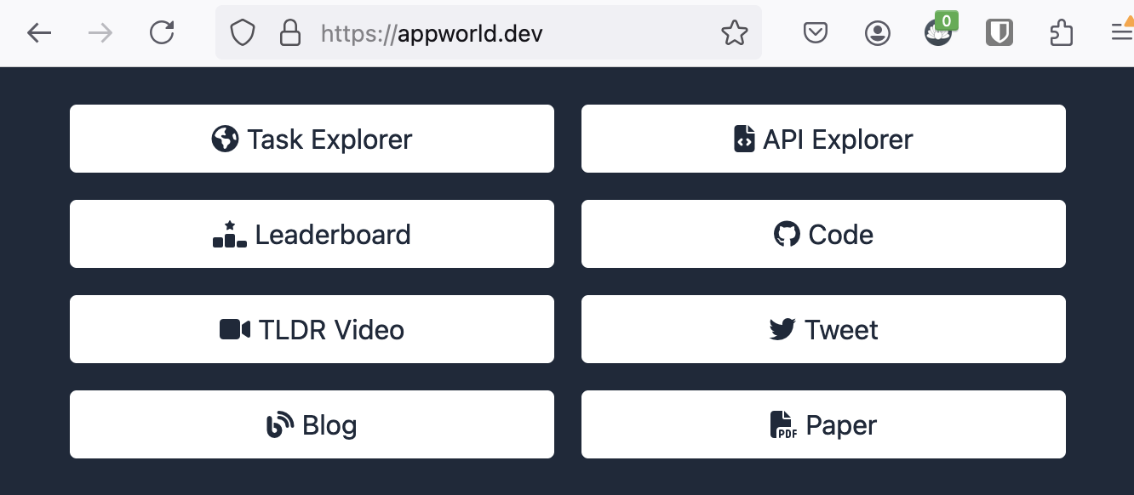

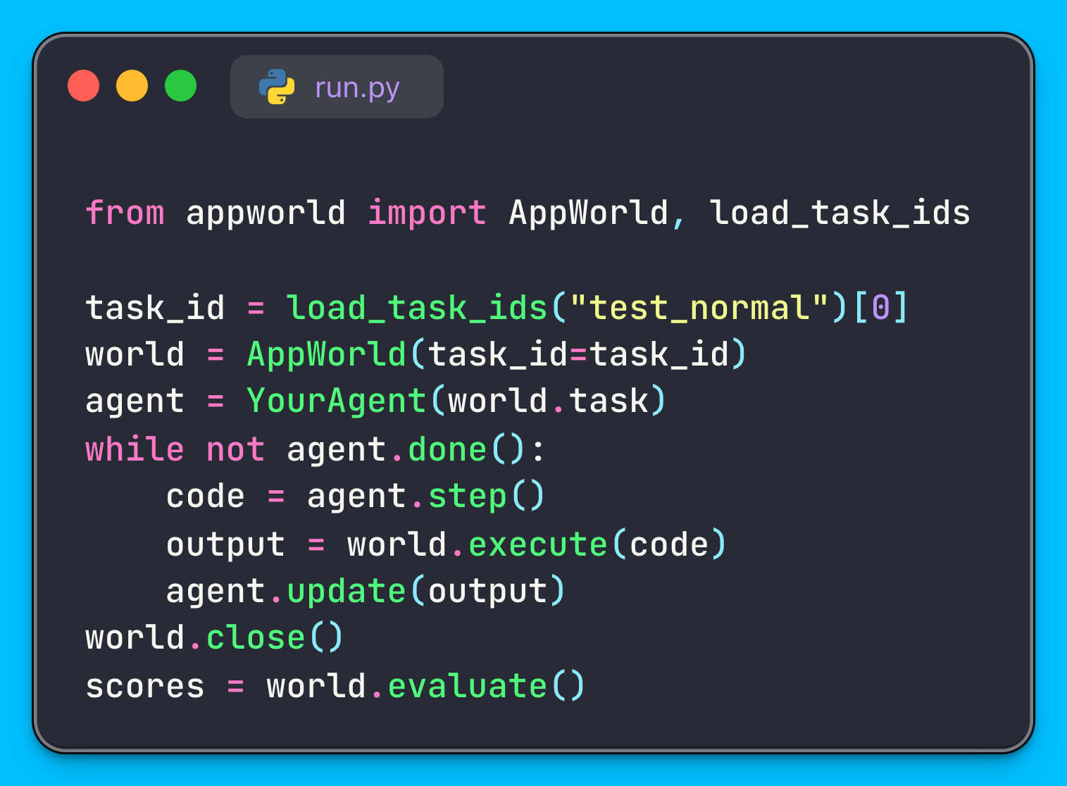


https://appworld.dev
Build & Test your Agent
🍰 AppWorld is Easy-to-Use!
Just ‘pip install appworld’ & start.
No docker / server necessary,
Comes with Jupyter-styled shell.
⚡ And it is Fast!
Tasks load in < 0.5s,
evaluate in < 0.6s,
& APIs respond in << 30ms.
Poster on
Tue 4-5:30pm
in Convention
Center A1
Few free
t-shirts!
Notes:
Visit our website for data explorer, playground, leaderboard and a lot more.
We have made appworld super easy-to-use and fast. You can pip install AppWorld’s python package and start building and testing your agents. If you have an agent, the code on the left is all you need to run and evaluate it on AppWorld.
Thank You!

Slide 53
Extra: How was DB populated

Slide 54
Extra: What is the human score

Slide 55
Extra: What are task variations

Slide 56
Extra: What not use real apps

Slide 57
Extra: Extra More Cmplx Task

